Slide 1

Major project on BLOOD BANK MANAGEMENT SYSTEM
SUBMITTED TO:-
Mr. Deepak Negi
SUBMITTED BY:-
Pooja Zinta(140610304031)
Premlata(140610304032)
Shivani(140610304052)
Saroj(140610304046)

Slide 2
CONTENTS
Introduction to project
Technology used in Project
Project Outline
About server
Introduction to HTML
Snapshots of Project
Future Scope
Conclusion

Slide 3
INTRODUCTION TO PROJECT
This project is designed to help collages for management of students details. Viewing student data and related issues are made simple and easy.
Users can visit our site and can get knowledge about the college and get to know about the current issues and news.

Slide 4
Technology used in Project
Hardware requirements:-
Software requirements:-
Processor : Intel Pentium-II , or higher version
Ram: 256MB, 2GB recommended.
Hardware devices: keyboard with mouse.
Hard Disk: 10GB or more.
Operating system:- window7/window 8/window 10.
Language used :- PHP, HTML
Database:- MYSQL.
User interface design: HTML, JAVASCRIPT.
Web browser: Mozilla, Google chrome, Internet explorer.

Slide 5
PROJECT OUTLINE
Objective
Scope of the project
Theoretical background
Problem definition
Methodology

Slide 6
OBJECTIVE
In order to successfully complete my project, a number of objectives firstly need to be defined:
The project titled “STUDENTS DETAILS” is developed for accomplishing all kinds of official work of educational institution.
The objective of system is to automate the process of maintaining various activities going on in an educational institution.
Produce a detailed requirement specification for the potential new Student Information System of Govt. Polytechnic for women Kandaghat

Slide 7
Scope of the project
Easy to manage Student’s and College’s records
• No more paper work
• No more errors due to manual work
• No more re-recalculation of fee or salary
• Instance reports generation
These are the main scopes of the project which provides a secure and reliable data stored to the systems.

Slide 8
Problem definition
Website of Student management system is a website that contains all the details of our students and anyone can know about students details online using this website.
Home: It is the main page of the website. Contains the link to the students records, Administrative etc. and contain the image slider which shows the institute vision.
About Us : It displays all the information about the history and location of the institution.
Students records: It displays the all the records of the students of computer engineering, eltx & comm. engineering and pharmacy.
Hostel:- It contains the all the details of the hostels of GPW Kanadaghat
Library:- It display the all details of the books in the library

Slide 9
METHODOLOGY
Dynamic Website :
The website of students management made by us in minor project is dynamic website i.e., Dynamic web page contains server side code, that allows the server to generate unique content when the page is loaded.
The content on dynamic web page changes regularly. The dynamic web pages are created using languages like PHP, HTML.
These are server side scripting language whose code remains on server. Dynamic web pages are created for making the web page interactive

Slide 10
ABOUT SERVER
WAMP is an acronym formed from the initials of the operating WAMPs are packages of independently-created programs installed on computers that used Microsoft Windows operating system.
System Microsoft Windows and the principal components of the package: Apache, MYSQL and PHP. Apache is a web server.
Other programs may also be included in a package, such as PHP My Admin, which provides a graphical users interface for the MYSQL database manager.

Slide 11
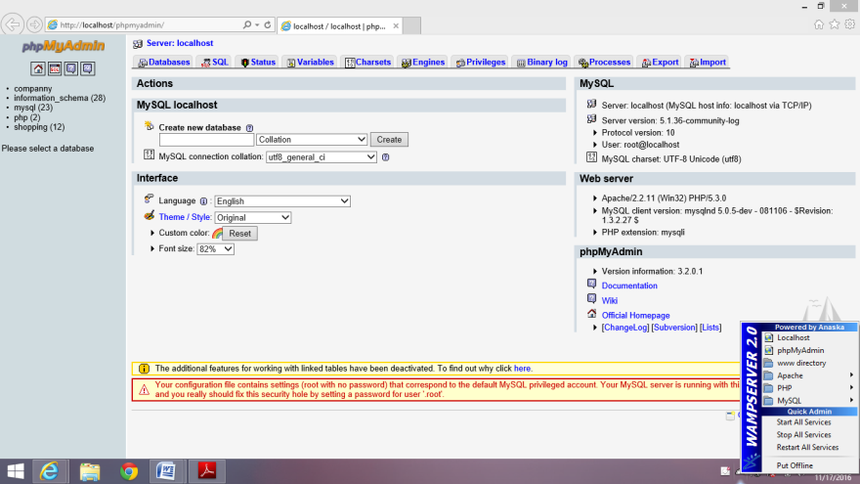
WAMP SERVER
Generally, only a user with administrator privileges can install a WAMP package. This means that these packages cannot be installed on many hosted services.

Slide 12
INTRODUCTION TO HTML
HTML or Hyper Text Markup Language is the standard markup language used to create web pages.
The word Hypertext refers to the which act as a link. we can jump to any web page on the internet clicking at the text which act as a link.
The word Markup refers to the symbols or sequence of the characters added to the ordinary text to define the structure of the text.
The word Language refers to the syntax that is similar to any other language.

Slide 13
HTML FILE STRUCTURE
<HTML>
<HEAD>
<TITLE>-------------------------</TITLE>
</HEAD>
<BODY>
---------------------------------------
---------------------------------------
</BODY>
</HTML>

Slide 14
HTML TAGS
PAIRED TAGS
UNPAIRED TAGS
<HTML>
<HEAD>
<TITLE>
<BODY>
Horizontal Rule <HR>
Line break <BR>

Slide 15
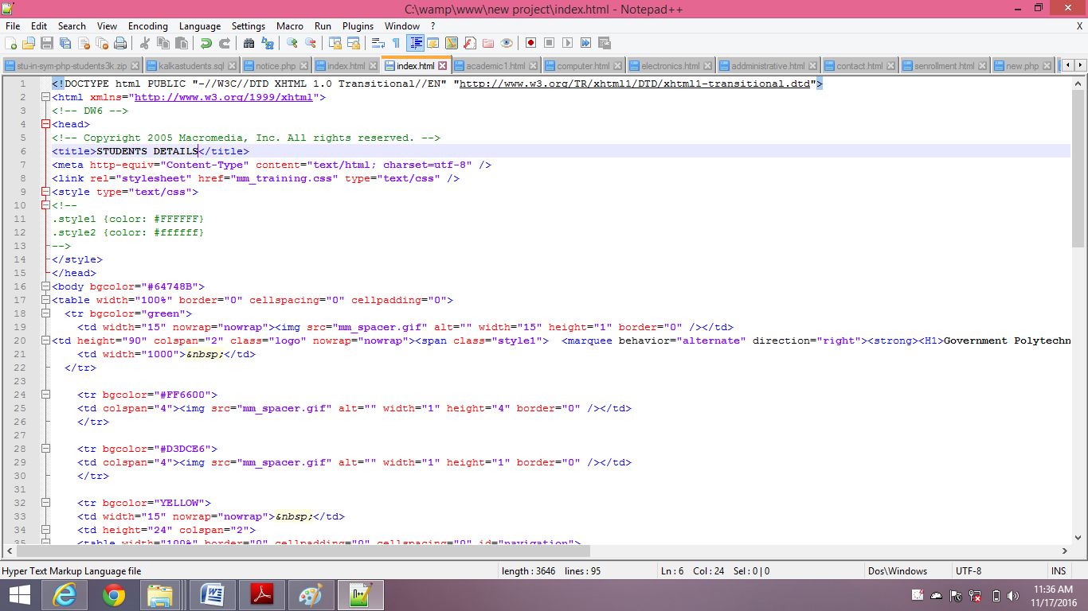
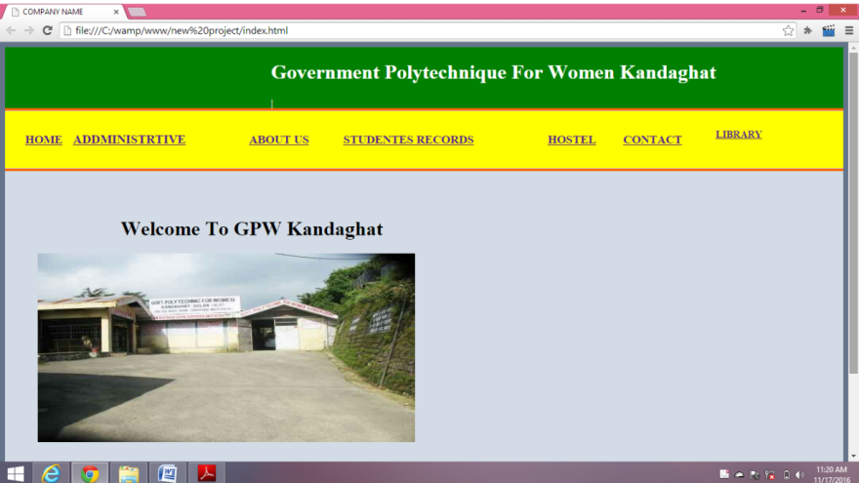
HOME PAGE
CODING OF HOME PAGE
OUTPUT OF HOME PAGE

Slide 16
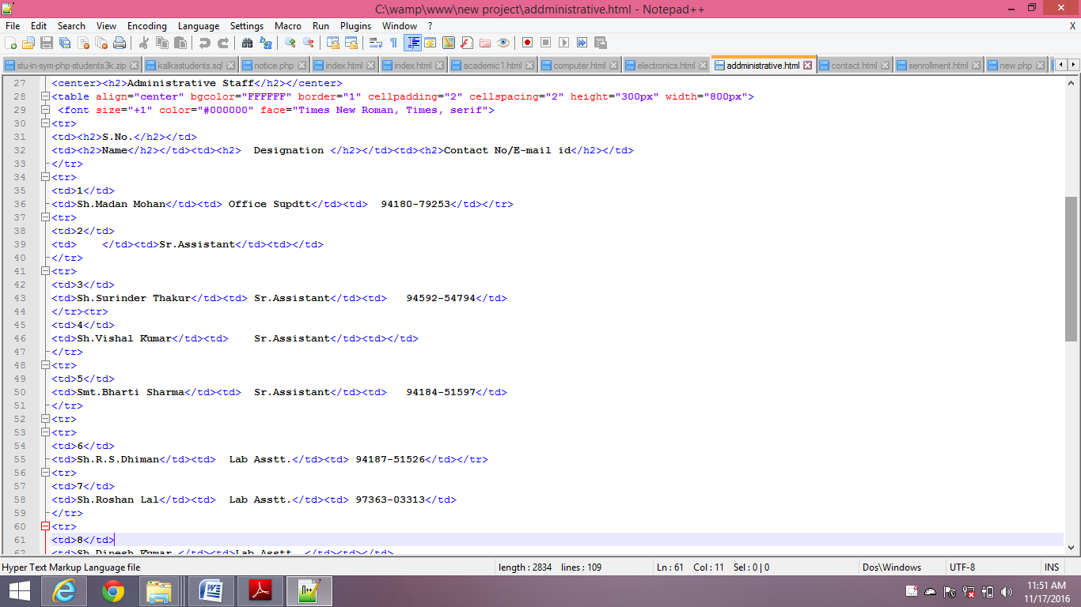
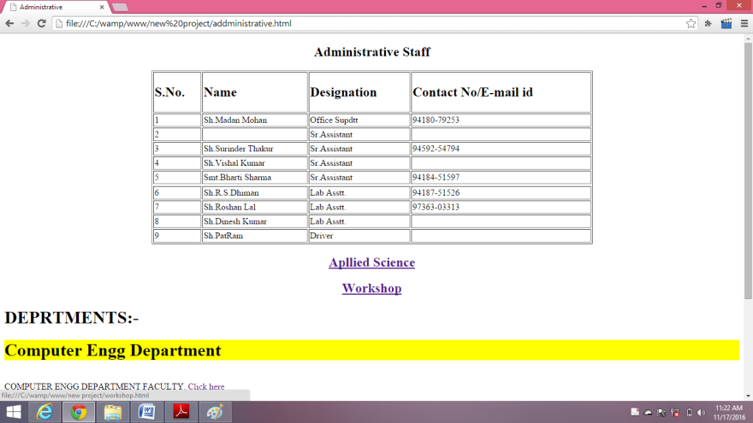
ADMINISTRATIVE PAGE
CODING
OUTPUT

Slide 17
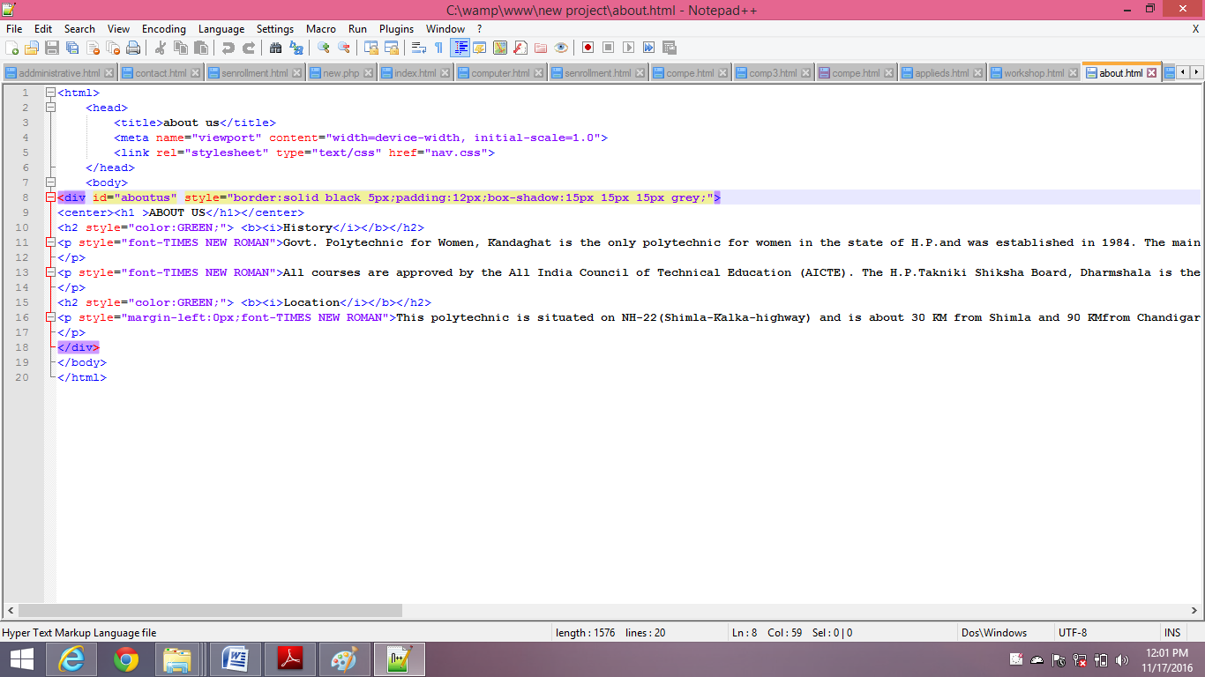
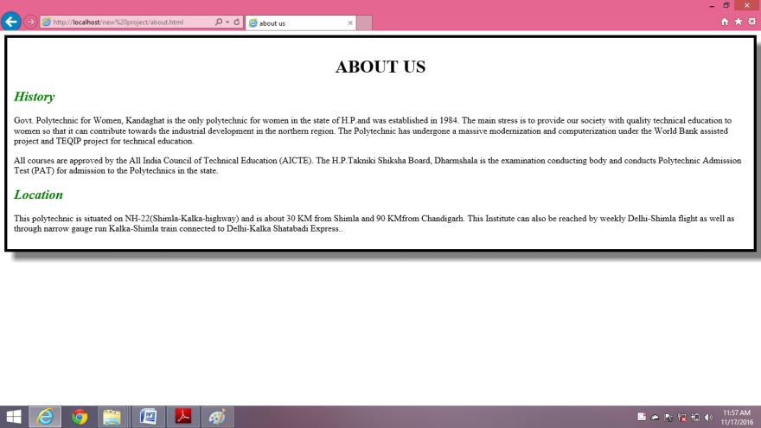
ABOUT US
CODING
OUTPUT

Slide 18
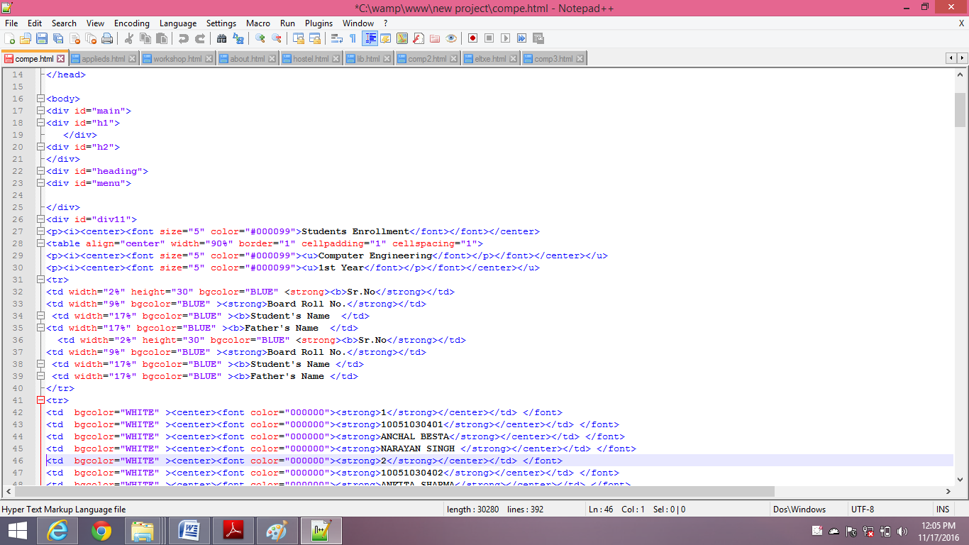
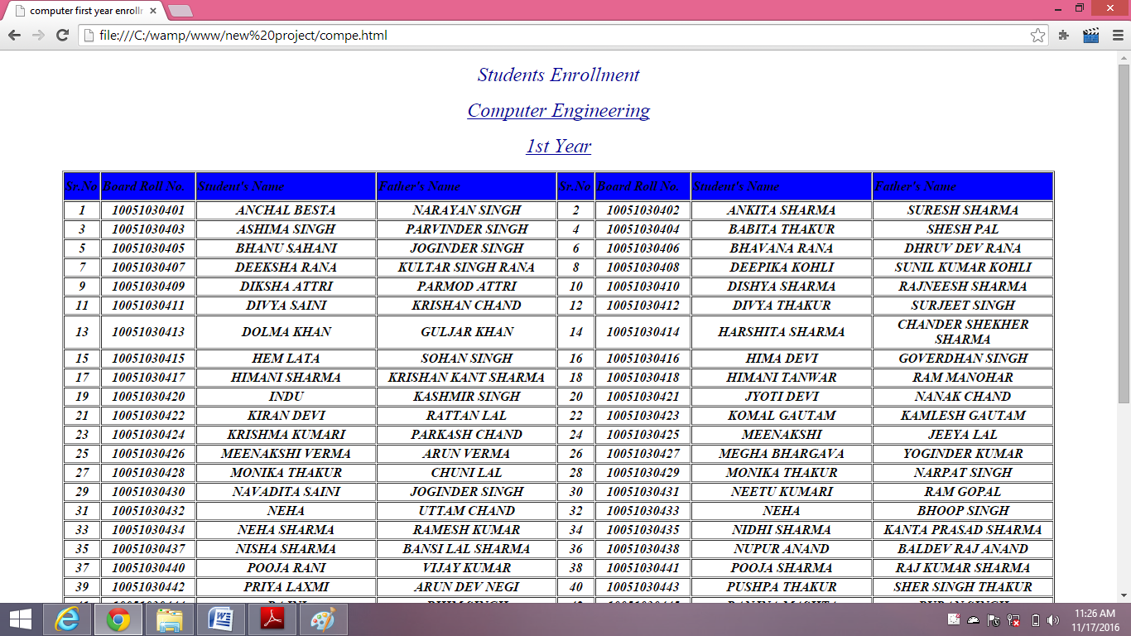
STUDENTS RECORDS
CODING
OUTPUT

Slide 19
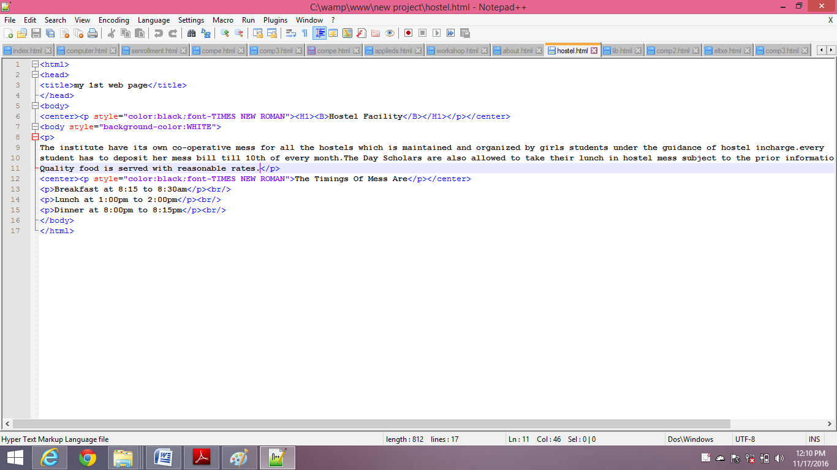
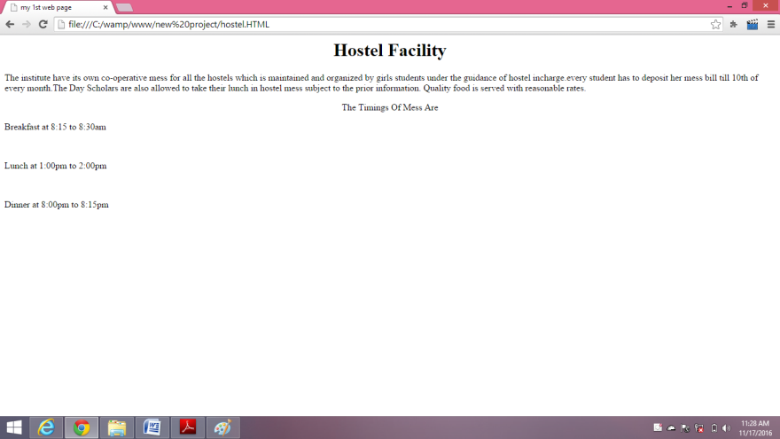
HOSTEL PAGE
CODING
OUTPUT

Slide 20
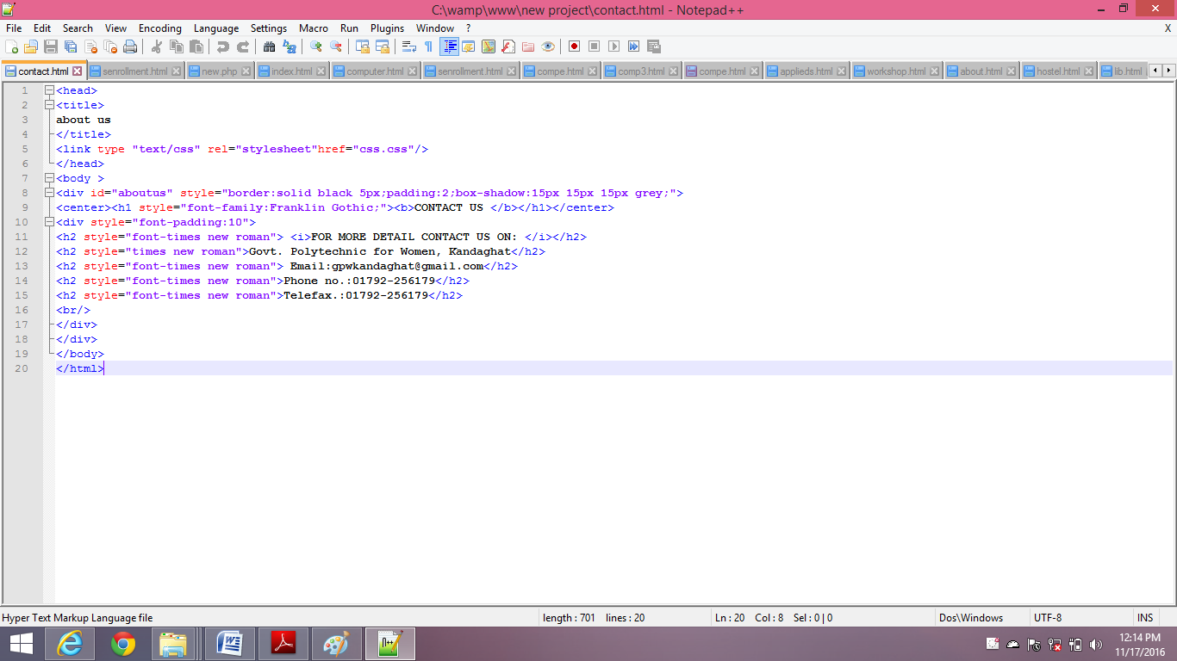
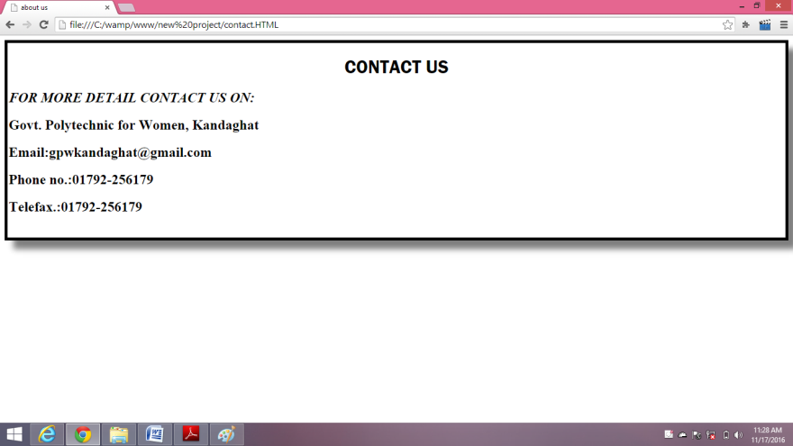
CONTACT US PAGE
CODING
OUTPUT

Slide 21
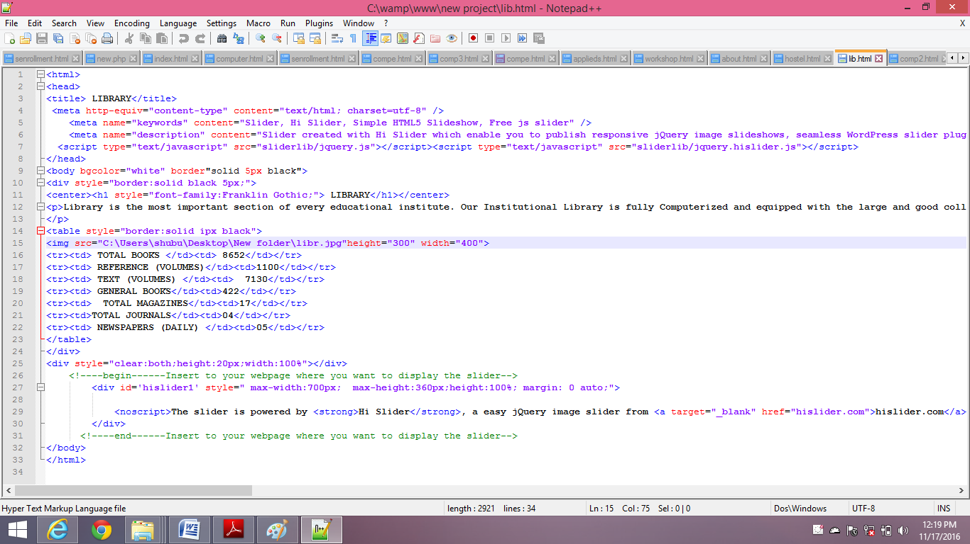
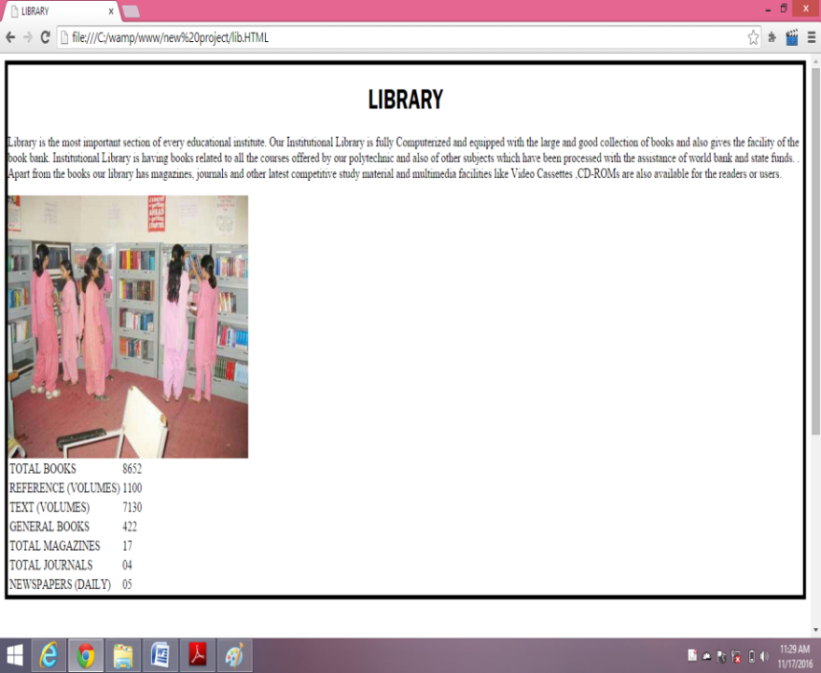
LIBRARY PAGE
CODING
OUTPUT

Slide 22
FUTURE SCOPE
Create an integrated website that projects a consolidated and consistent image.
Easy to manage Student’s and College’s records.
To increase visibility of college services options.
To provide features that makes the website part of a student’s daily functions.
To ensure training and technical support is in place to maintain the site.

Slide 23
CONCLUSION
With all the accumulated efforts invested in making of the website. We summarize the progress with respect to the main objective of the project, namely, scalability, convenience and accessibility.
This project is user friendly and has required option, which can be utilized by users to perform desired operations.
No more paper work.
No more errors due to manual work.
Instance reports generation.

Slide 24

THANK YOU
HAVE A NICE DAY

